Slide 1

Capstone Project
Yuran Pan
Notes:
Explore the Data clean up the data,

Slide 2
Data Exploration
16 data fields, 213451 records
87990 missing data in Age field
The target variable is Country Destination
Around 58% of observations is NDF
Lot’s of unknown values for gender

Slide 3
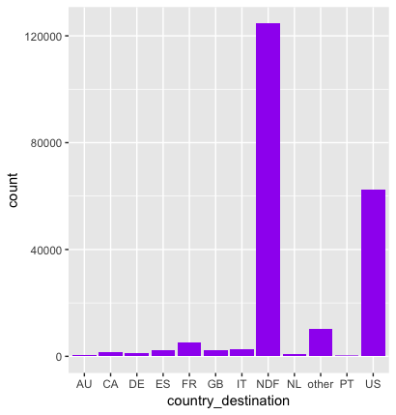
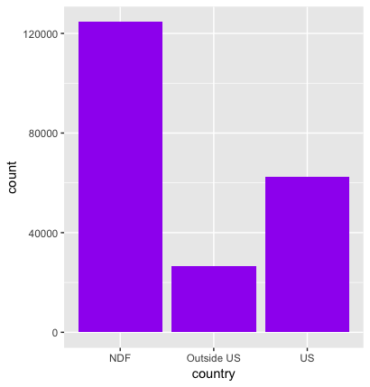
Data Pre-Processing
Country Destination
Majority of the observation is NDF, with US the most booked destination
Re-group the destination into NDF, US, and outside US and name it Country

Slide 4
Data Pre-Processing
Gender
44.8% of –unknown
Assign –unknown- with female or male based on the distribution of gender in each country
With country to NDF: 67050 female, 57387 male, 106 other
With country to the US: 33553 female, 28707 male, 116 other
With country to outside US: 14021 female, 12451 male, 60 other

Slide 5
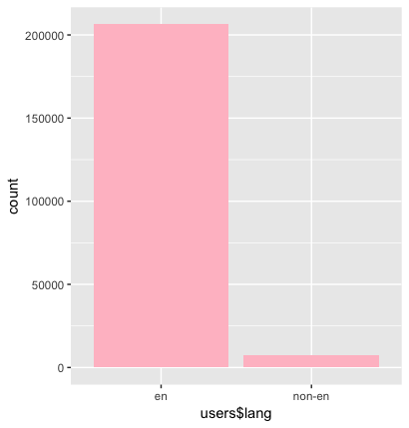
Data Pre-Processing
Language
Most of people speak English
Re-group the field into English or non-English and name it Lang

Slide 6
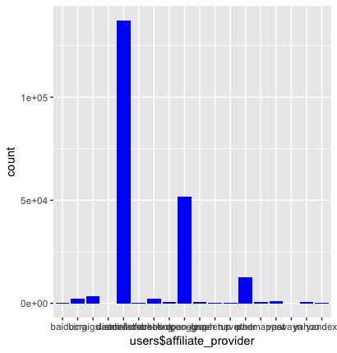
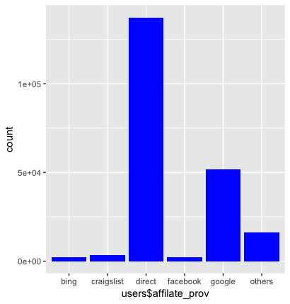
Data Pre-Processing
Affiliate Provider
Retain the top 5 affiliate providers and group the rest into ‘others’
Name the field affiliate_prov

Slide 7
Data Pre-Processing
Age
Max age of 2014 and min age of 1 is unrealistic
Assuming 1924 to 2014 is birth year
Allowing min age of 15 and max age of 100
Group the reasonable age into 8 age categories with a 10-year step

Slide 8
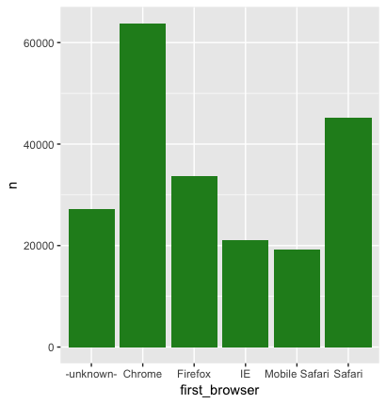
Data Pre-Processing
First Browser
Select top 6
First device type
Mac and Windows desktop are the mostly used device across countries

Slide 9
Data Pre-Processing
Create a new field called dt_diff
Take the difference between date account created and date first booking
Group the days difference into sameday_booking,2-7 days,8-30 days, 31-90 days, and > 3 months

Slide 10
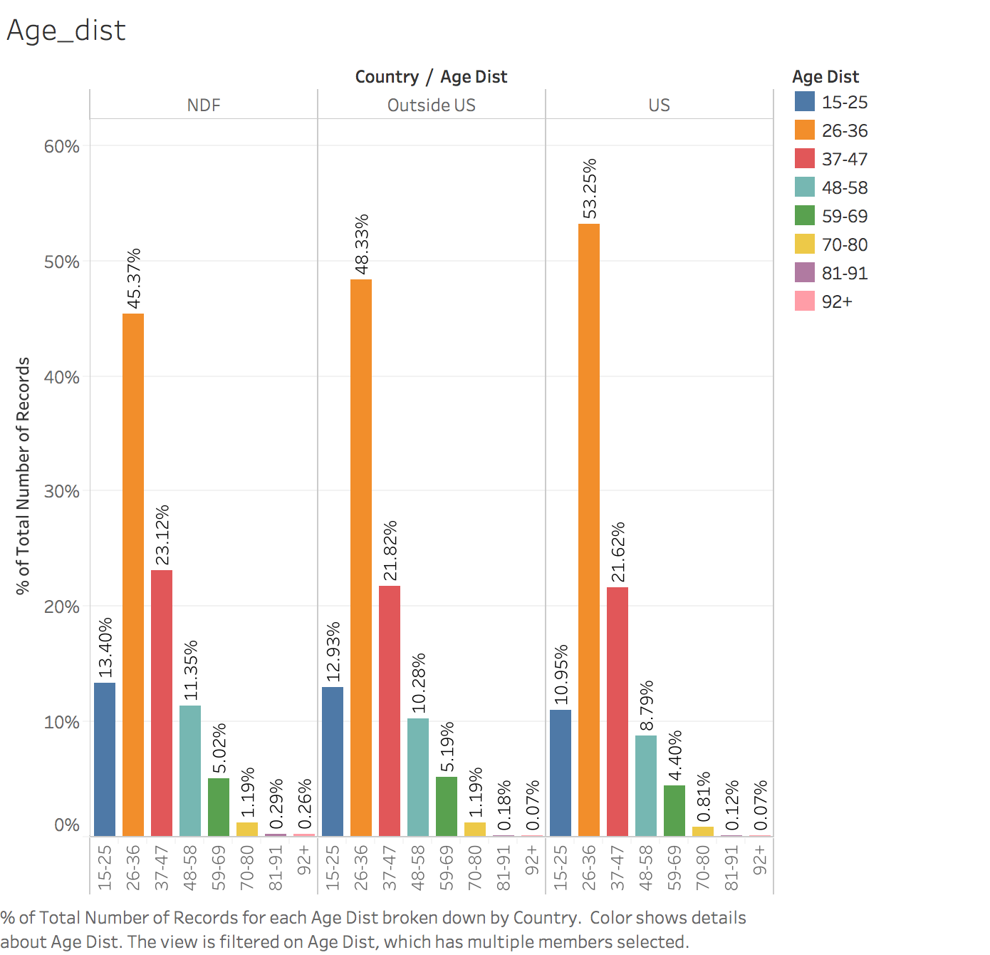
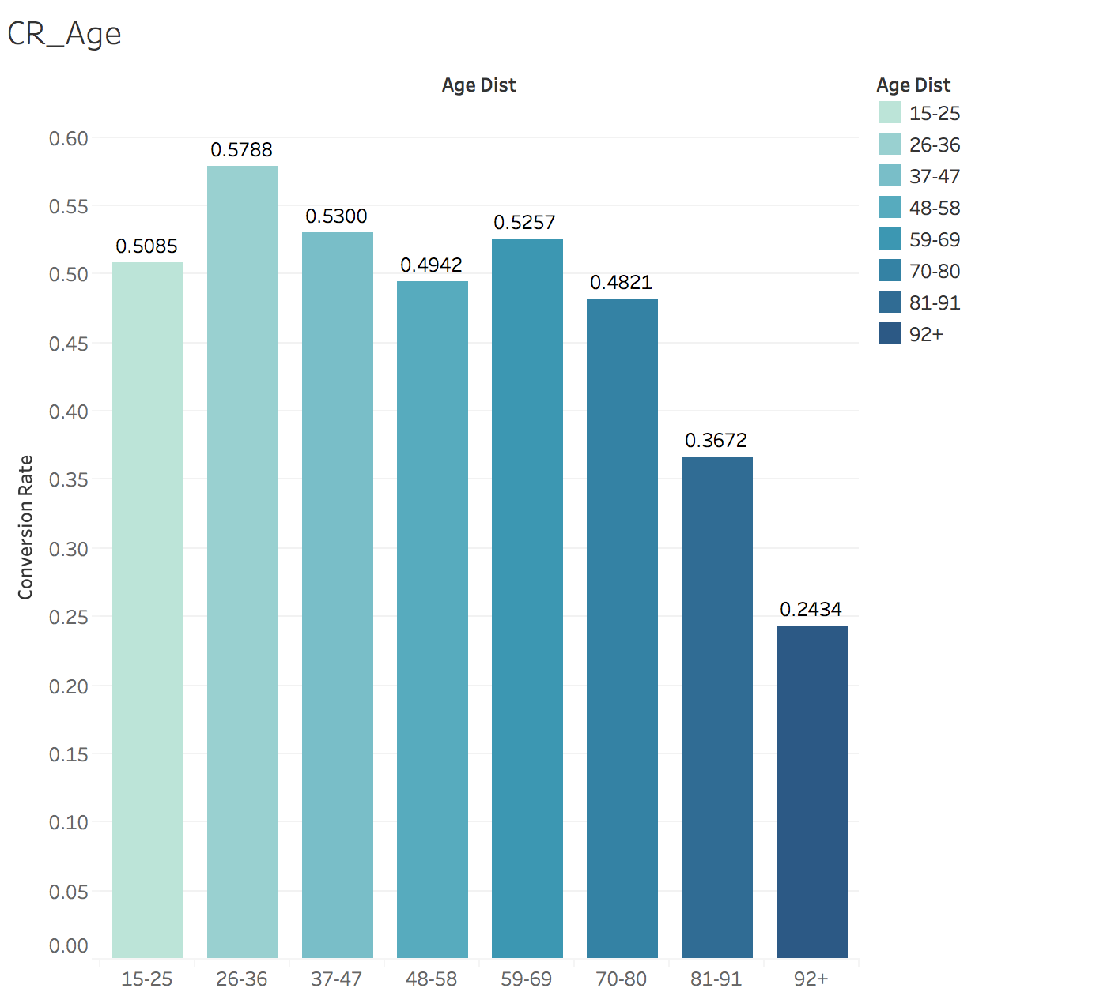
Data Visualization
Age distribution
The age distribution between 26-36 is more likely to travel in general
Likewise, people between 26-36 has the highest conversion rate
Even the they are less likely to travel than 15-25 age group, people between 59-69 have relatively high conversion rate

Slide 11
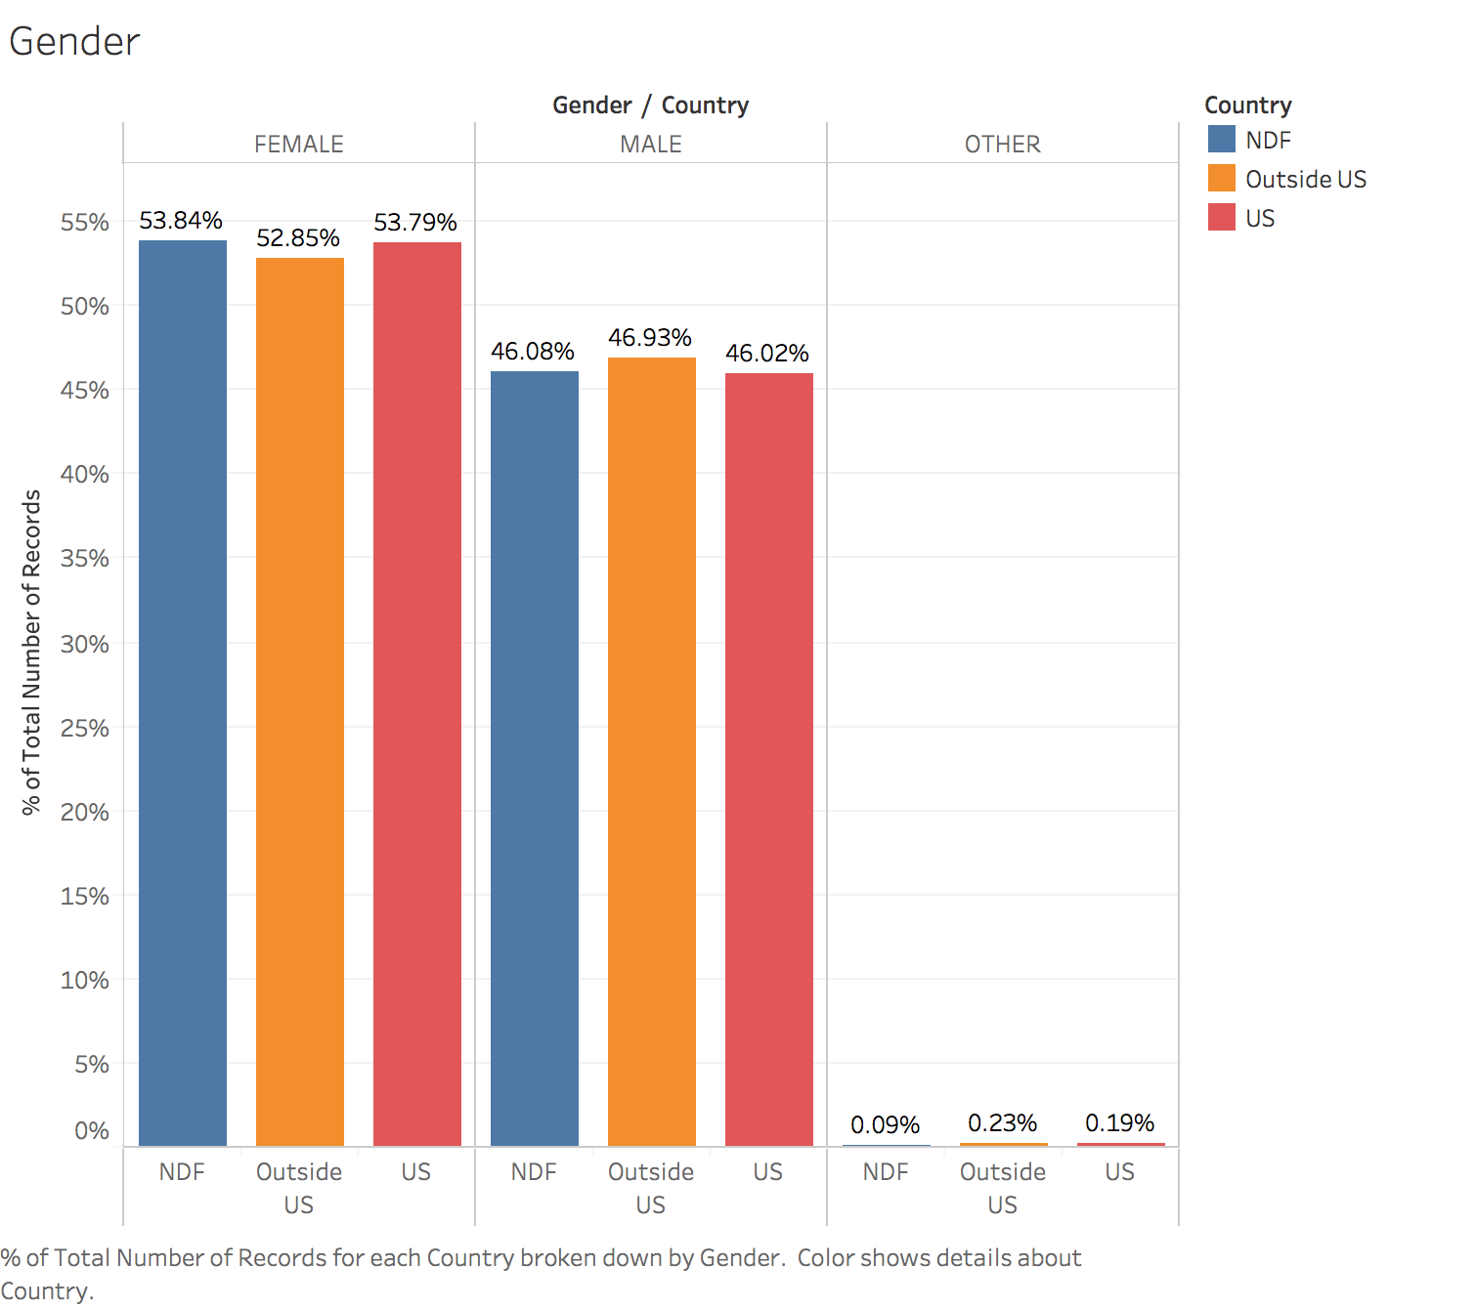
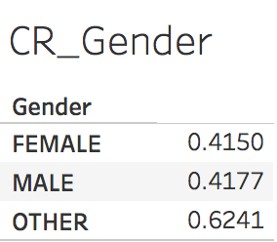
Data Visualization
Gender
No significant difference between country destination for female and male
While, 6%-8% more female than male book a trip with with Airbnb, there’s no significance in conversion rate between female and male(41.5% vs 41.77%)

Slide 12
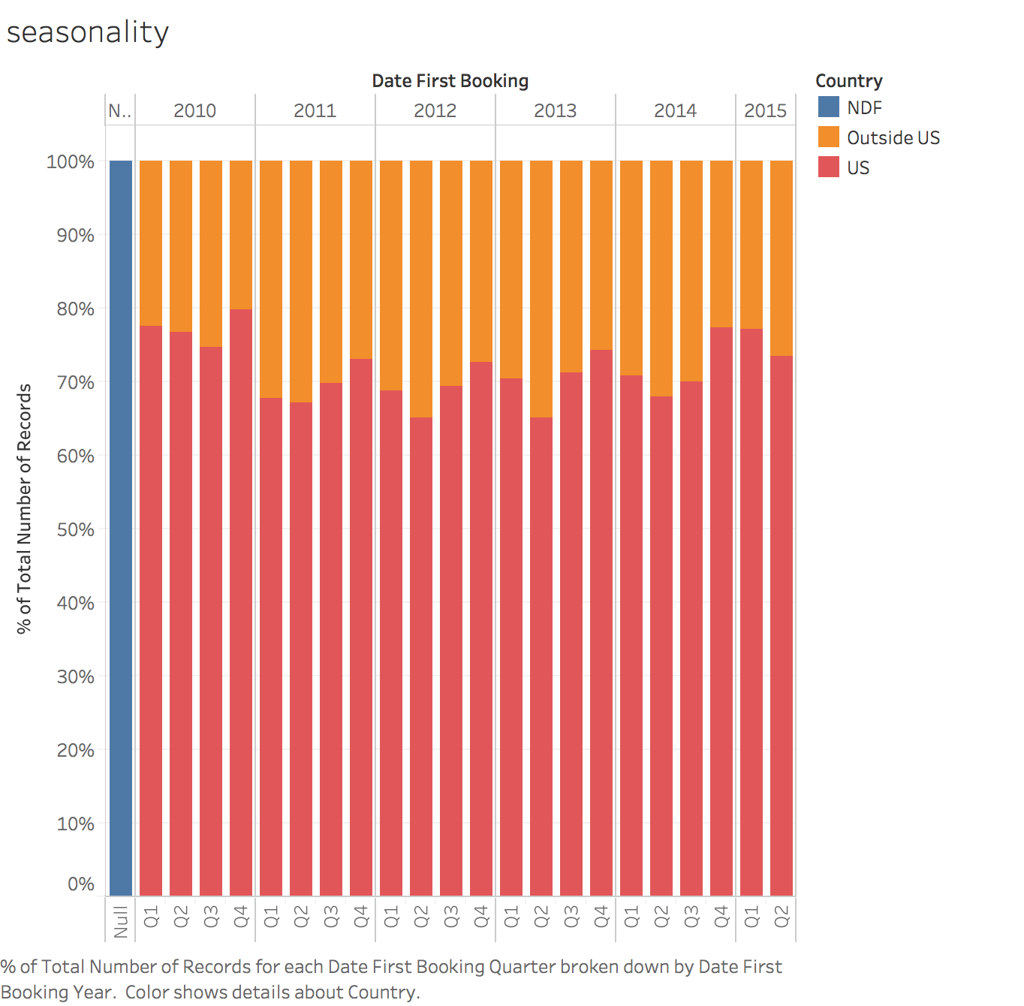
Data Visualization
Seasonality pattern
People tend to book a trip to US the least In Q2, the most in Q4 of a given year

Slide 13
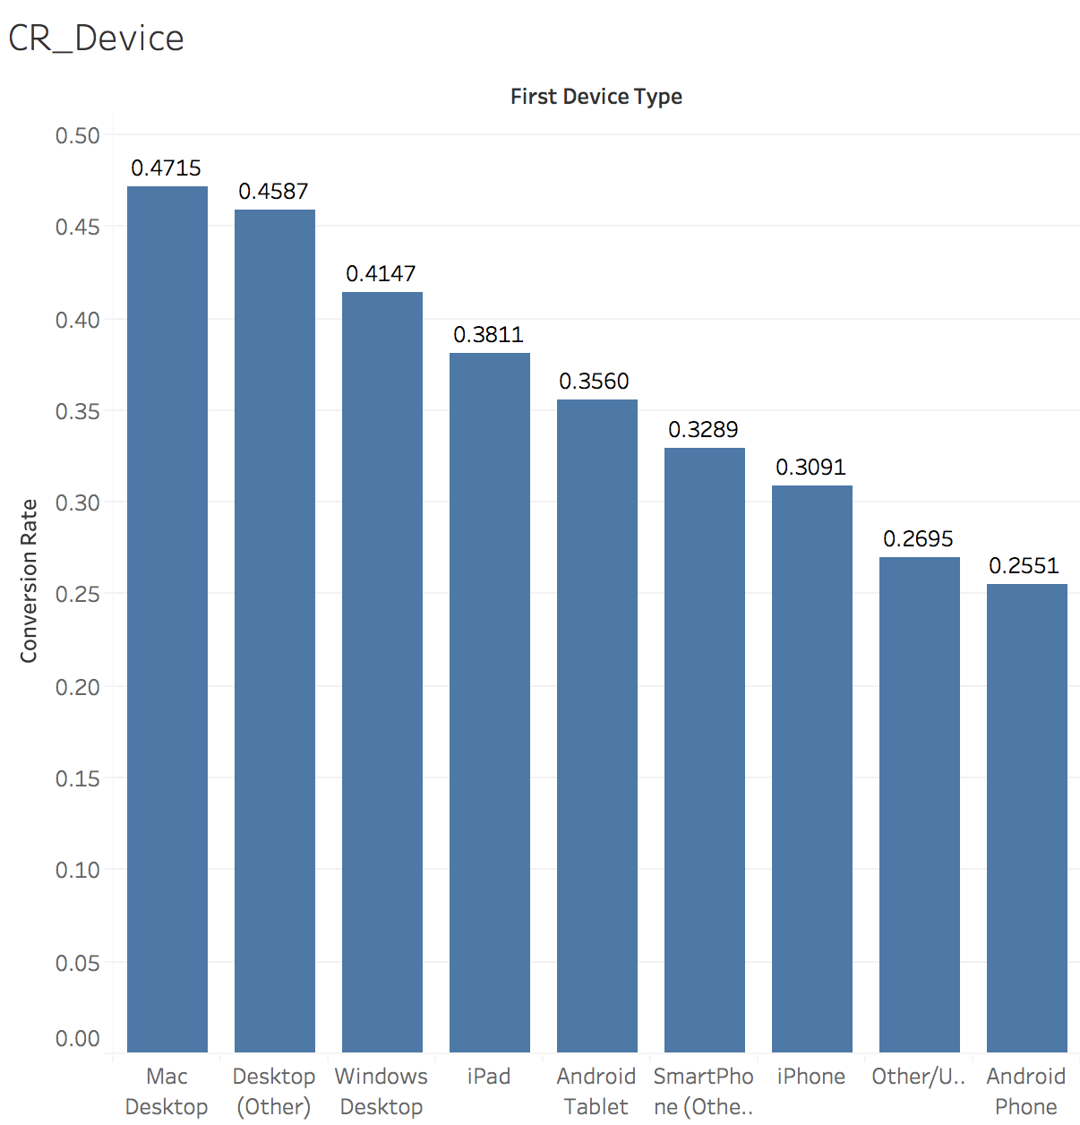
Data Visualization
First Device Type
People who use Desktop have a higher conversion rate than people who use phone
Bigger screen to share the pictures with family and tour mates

Slide 14
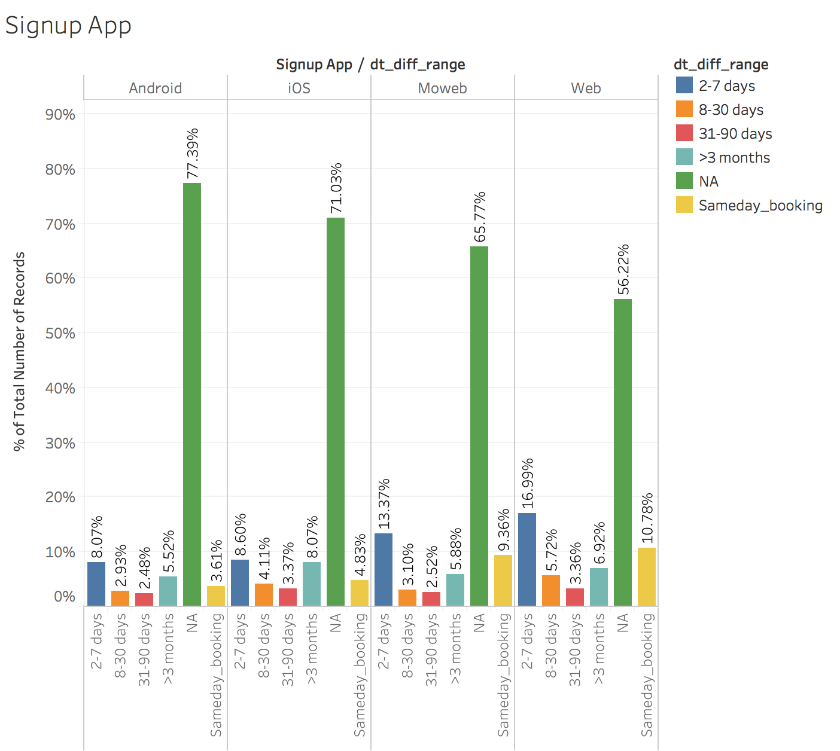
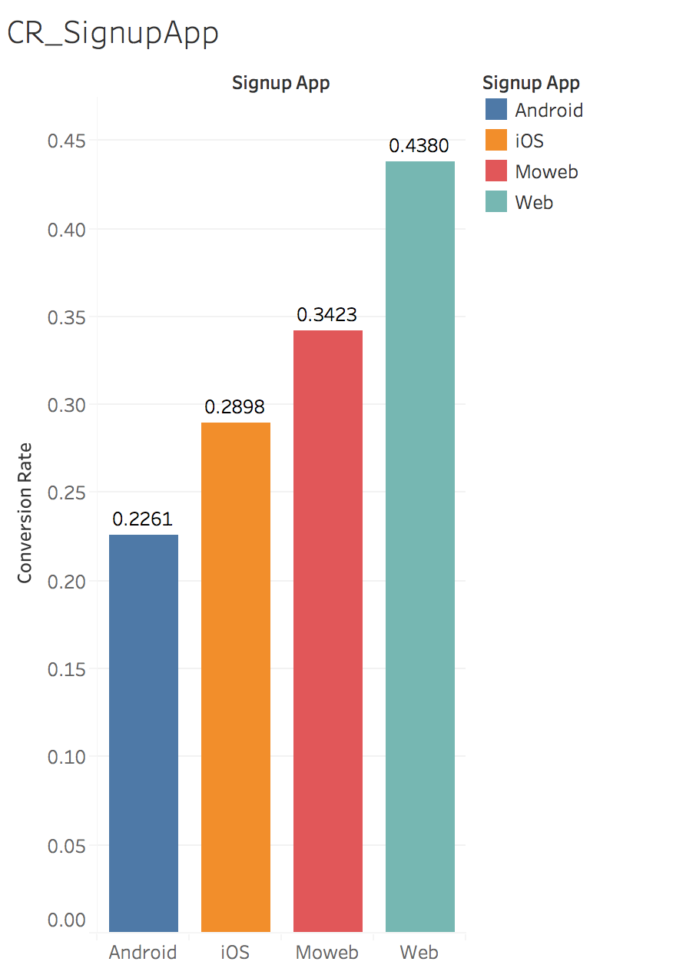
Data Visualization
Signup Method
Among the 4 signup methods, Web and Moweb have more people that fall into same day booking and 2-7 days waiting period. Conversion follows the same pattern as lag time. So the more time people have waited, the less likely they will book the trip with Airbnb

Slide 15
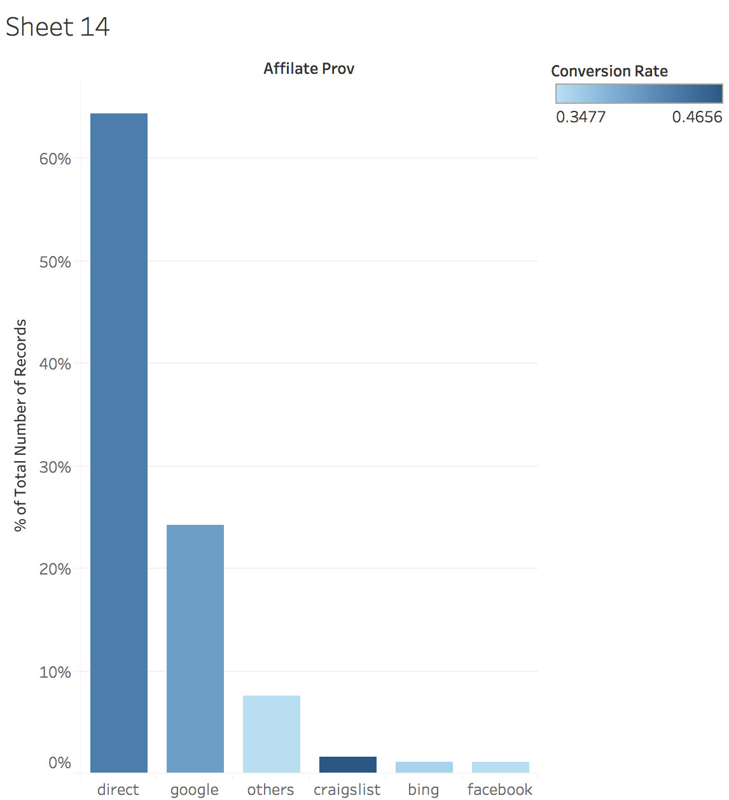
Data Visualization
Craigslist has the highest conversion rate despite low share among affiliate providers. Increase budget on putting ads on Craiglist

Slide 16
Thank you

